Slide 1
Water Contract Research Committee Results
Nathan Davis, Presenting

Slide 2
Why This Committee Was Formed
GMWSD must follow rules that are scattered throughout many documents, many of which were written long before any current board members were in their positions.
There are a few ambiguous areas in these documents which several board members have been seeking clarification on for some time now.
A full legal review of all these documents would be too costly, but a targeted review of key areas identified by the committee may be more reasonable.

Slide 3
Relevant Documents
1995 Master Meter Water Service Agreement
1974 Denver Water Agreement
2007 Denver Water Operating Rules
City of Denver Charter
State of Colorado Revised Statutes

Slide 4
Research Topic 1: Comparing our Contract to Other Districts
One objective was to review the Master Meter contracts of other districts in the service area and determine if there were any meaningful differences between their MM contracts and ours so we could push for any advantages that other districts have which we do not.
We gathered the relevant documents from districts in the area by contacting their District Managers and making a CORA request with Denver Water.
During this process, several DMs told us that Denver Water standardized the MM contracts in the 90s.
In the MM contract for Ken Caryl Ranch, we found specific language which seems to confirm that this standardization took place.
In other words, we do not appear to be getting a worse deal than other MM districts.

Slide 5
Standardization Language in Ken Caryl Ranch’s 1993 Master Meter Contract

Slide 6
Research Topic 2: Can Denver Cut Off Our Water in the Future?
There are several places in the 1995 Master Meter contract, 1974 Denver Water Agreement, and Denver Water Operating Rules which indicate that there is a vaguely defined limit to how much water Denver is able to provide to districts outside of Denver.
This has been frustrating for GMWSD because those documents also say that Denver believes there will be enough water for “full development” within its service area based on engineering projections which the document does not elaborate upon.
Our committee’s objective here was to get a more specific understanding of the circumstances under which Denver could cut off or limit our water in the future so the Board can operate with that information in mind.

Slide 7
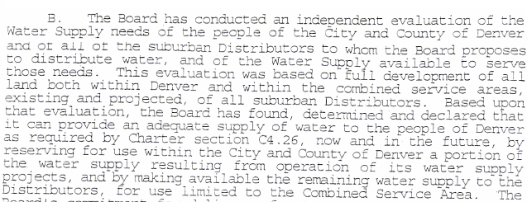
“Adequate Water”
1995 Master Meter Contract
Denver Water Operating Rules

Slide 8
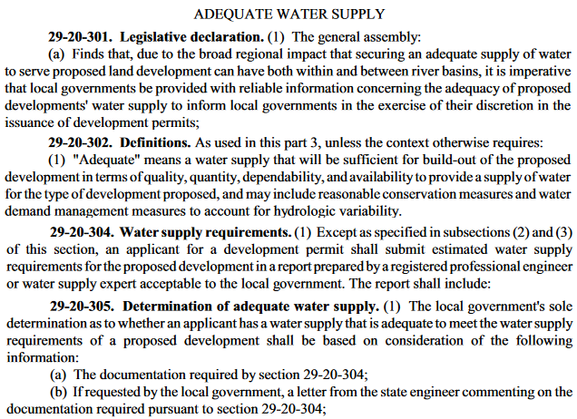
“Adequate Water” cont.
Denver City Charter
§ 10.1.13 - Water leases.
The Board shall have power to lease water and water rights for use outside the territorial limits of the City and County of Denver, but such leases shall provide for limitations of delivery of water to whatever extent may be necessary to enable the Board to provide an adequate supply of water to the people of Denver.
Colorado Revised Statutes

Slide 9
“Adequate Water” Conclusions
The references to “adequate water for Denver” in our documents are included because Denver Water has a legal requirement to include them.
Based on the Colorado Revised Statutes, “adequate” specifically means that a development has enough water to meet the estimated water needs that were submitted and approved when the development applied for its permit.
Therefore, the practical definition of “adequate water for Denver” appears to be the sum of the estimated water needs as documented in the water estimate submissions from all the developments that are supplied water within the City of Denver.
It seems likely that Denver Water wouldn’t invest the resources to keep track of this legal definition of adequate if their engineering projections indicated there wasn’t a water crisis.

Slide 10
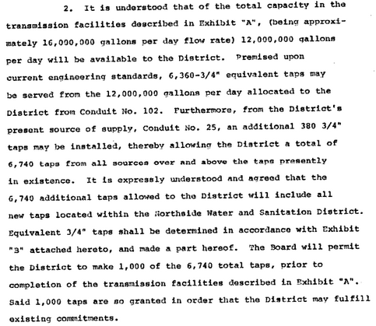
1974 Agreement’s “Tap Limit”
This section of the 1974 Water Agreement appears at first glance to establish a set limit to how many taps GMWSD could use. Upon closer reading, this language appears to be describing the technical capabilities of the transmission facility at the time rather than establishing a legal cap on tap allowanced for the district. This interpretation would resolve the contradiction with the “full development” language in the 1995 Master Meter contract.

Slide 11
Drought Rules
The Operating Rules define four “Stages” of drought countermeasures, which apply to everyone in their integrated system equally (for now).
Denver has not yet defined the specific measures that will be taken in a Stage 3 Drought. It seems probable that we would need to reach that point before Denver would consider rule changes that would allow them to treat distributors differently than they treat Denver in terms of water use restrictions.
Put another way, Denver and its distributors all appear to be in the same boat in terms of possible future water restrictions. Barring a policy change, Denver can’t limit GMWSD without also limiting Denver.

Slide 12
What About Denver’s Projections of “Full Development”?
Per our 1995 Master Meter contract, Denver’s agreement to provide us with water appears to be legally premised on the accuracy of the engineering projections that they made at the time.
We now know that these engineering projections would have likely been separate from the legal meaning of “adequate for Denver”.
There is no clear reference in our MM contract to any specific engineering study that Denver’s projections were based on. With further research, we may be able to infer more about what Denver’s engineers might have been thinking at the time, but that would constitute a separate research project.

Slide 13
Conclusions
GMWSD does not appear to have a worse contract than other nearby Master Meter districts.
The “Adequate water” language that shows up in our documents appears to reference a specific legal definition based in Denver and Colorado statute that is difficult but possible to quantify.
The apparent tap limit in the 1974 Agreement seems to actually be more of a technical evaluation of the capacity of the facilities available at the time.
Under the current Operating Rules, Denver can’t impose water restrictions on distributors that aren’t also imposed on Denver. This could change in the future, but probably not before Denver defines what “Stage 3” drought restrictions look like.
It remains unclear what Denver’s 1995 engineering projections supporting “full development” were based on. Further research into the historical supply/demand for the system’s water may provide some insight on this, but that project would need more time and a separate PowerPoint presentation.

Slide 14
Next Steps
Confirm the committee’s findings with a legal expert.
Decide if it’s worthwhile to investigate whether the current and future supply/demand for water is still in line with the “full development” projections Denver made in the 90s.
Communicate the committee’s findings to other Master Meter districts.

